Slide 1


Week 3: Turn construction
Ryan Ka Yau Lai
University of California, Santa Barbara

Slide 2
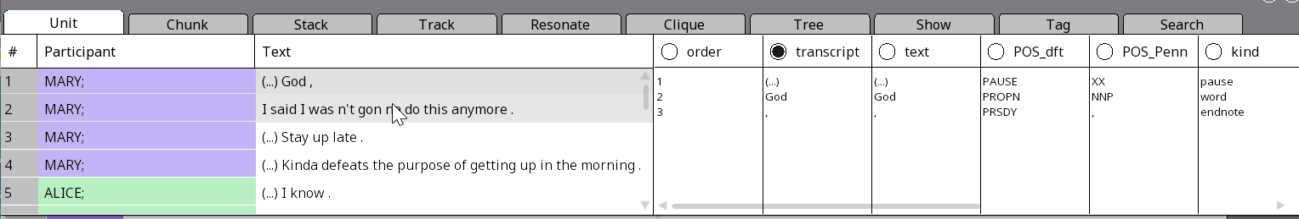
While we’re waiting …
Open SBC007 on Rezonator
Preferably a previously saved version
Open the audio file
Change active display to the transcript field
Note today’s codeword and question on the board
Shameless plug: You can still enroll in LING 194 Visualising language in conversational interactions, which I teach in summer!

Slide 3

Question for today
Give one example of a TCU from SBC007, and describe what happens at the end of that TCU in terms of the simplest systematics.
[Please send me a screenshot if possible.]

Slide 4
In this class, you will …
Review
Review common transcription symbols
Understand
Understand some common mistakes and questions we’ve seen regarding turns and backchannels
Annotate
Annotate TCUs in Rezonator
Learn
Learn how to write a good show and use linguistic evidence to argue for a position

Slide 5
Common transcription conventions
Convention | Meaning
(%) | Glottal release
(H) | Inbreath
(Hx) | Exhalation
@ | Laughter
(TSK) | Tsk-tsk
Convention | Meaning
(.) | Shorter pause
(…) | Longer pause
# | Unclear
[ ] [2 ] | Overlap brackets
wor:d | Lengthening

Slide 6
Common mistakes – turns and backchannels
Don’t just identify backchannels based on what word it is (yeah, right, etc.)!
Think about whether the function of the backchannel is really just to tell the other person to continue without taking the floor
Words like yeah, right can be used to respond to questions (minimal response) or even take the floor in some situations
The sad story of ‘okay’ in the textbook …
Don’t merge lines from different speakers into the same turn
There are rare cases where this makes sense, but consult us first if you really think this is correct (99% of the time, it’s not …)

Slide 7
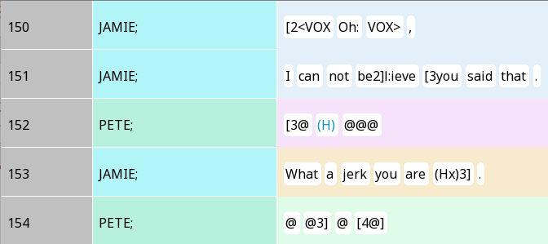
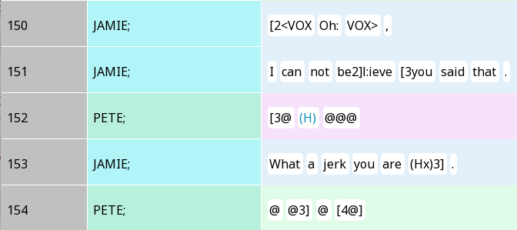
Vocalisms – breath and laughter
Does Jamie start a new turn in Line 153?
For sure, it is a new TCU
But Jamie is not responding to Pete’s laughter
Pete doesn’t seem to want to take the floor with the laughter, either – he’s just laughing …

Slide 8
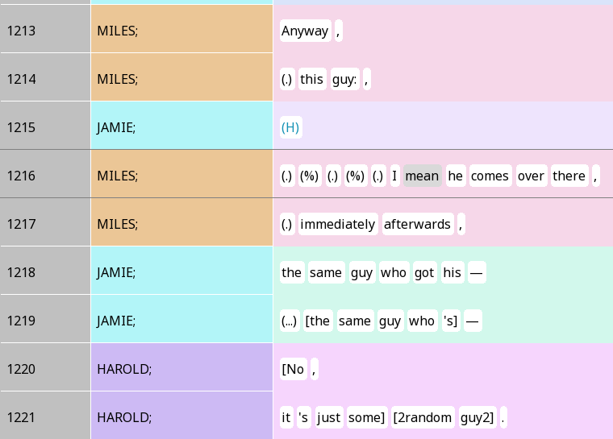
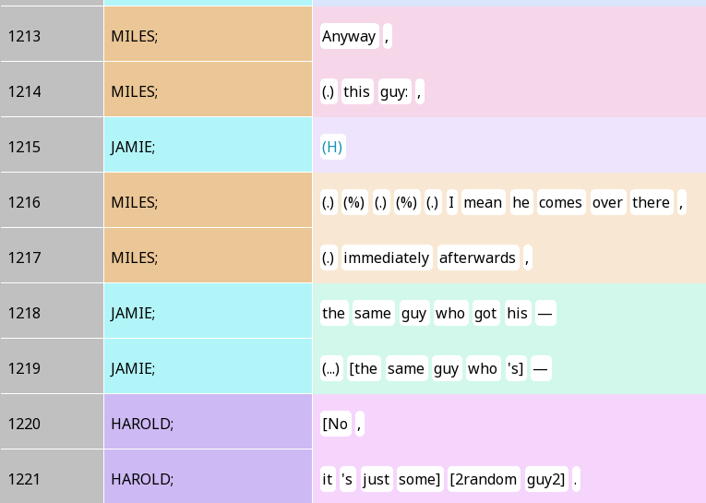
Breaths as a floor-taking cue
Jamie was probably trying to start asking who the guy was in line 1215
But is Miles responding to that in 1216?

Slide 9
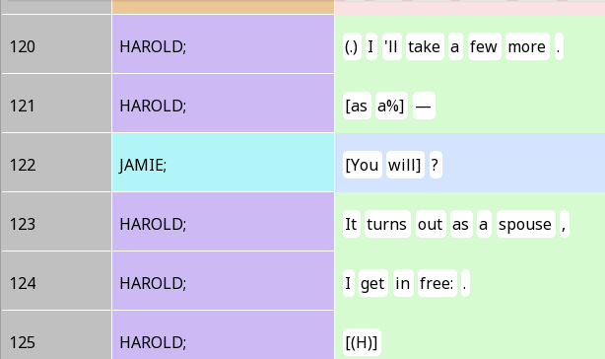
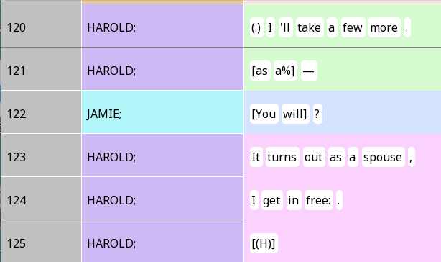
Turn competition
At a TRP (after more), Jamie briefly takes the floor, but Harold tries to start another TCU
After the overlap, Harold seems to be trying to re-start the TCU he just started
Do you think Harold’s speech is 1 or 2 turns?

Slide 10
Simplest Systematics
Two components
Turn-construction component
Turn-allocation component
Two rules (3 + 1)
1abc: What happens at a transition-relevance place (TRP)
2: What happens at future TRPs

Slide 11
Four types of ‘endnotes’ (intonation symbols) in discourse-functional transcription
,
Continuing (‘comma’, stable)
?
Appeal (‘question mark’, markedly rising)
.
Terminating (‘period’, markedly falling)
--
Truncation (‘dash’, prematurely ended intonation unit)

Slide 12
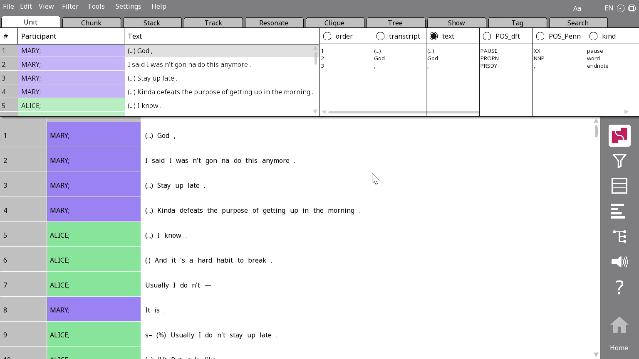
The Utterance stacker
Tools > Stacker > Utterance
Replace Utterance with TCU, press OK
Lines from each participant are divided into utterances by periods (.), question marks (?)

Slide 13
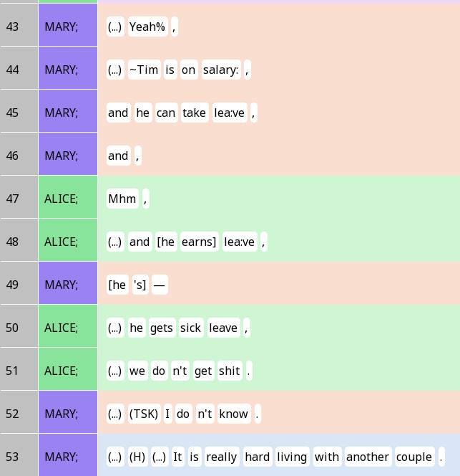
How well does the Utterance stacker reflect TCUs?
Any TCUs you might want to split up?

Slide 14
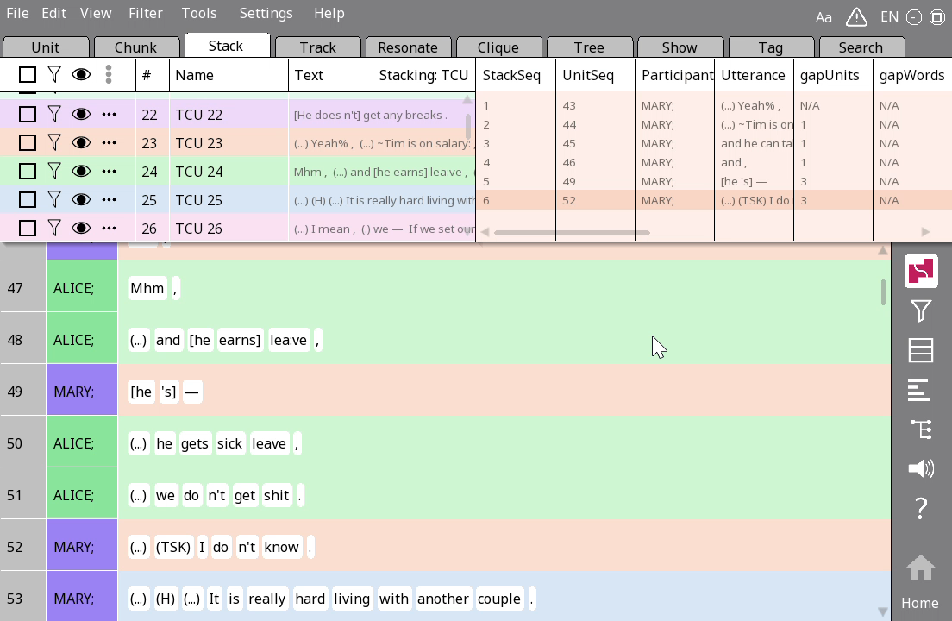
Splitting stacks
Right-click on lines you want to remove from the stack and press Remove from stack
Press Esc to escape from the current stack
Create a new stack using the drag-and-drop stack creation feature

Slide 15
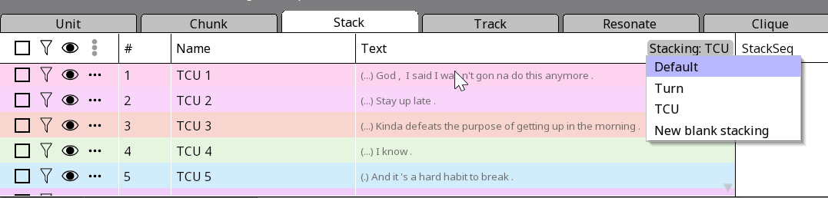
Stackings
A set of stacks of the same type
Previously, we had a Turn stacking
Now you have a TCU stacking too
You can switch between stackings

Slide 16
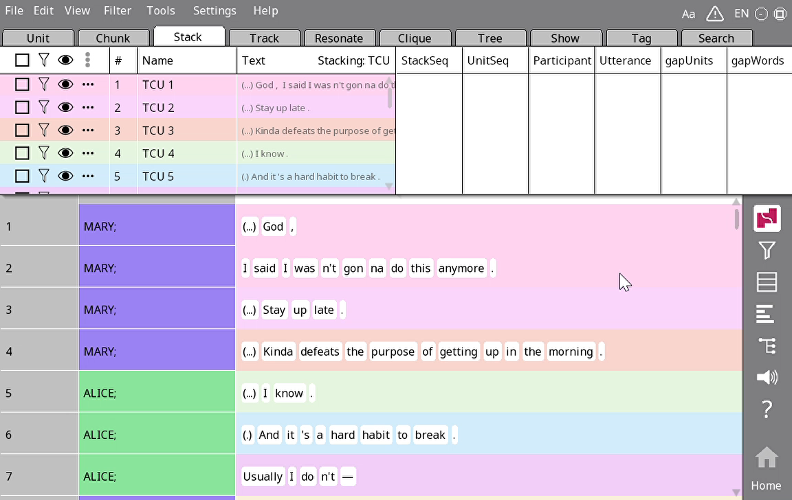
Creating blank stacking from scratch
Click on Stacking: [TCU] > New blank stacking
Let’s call it excerpts

Slide 17
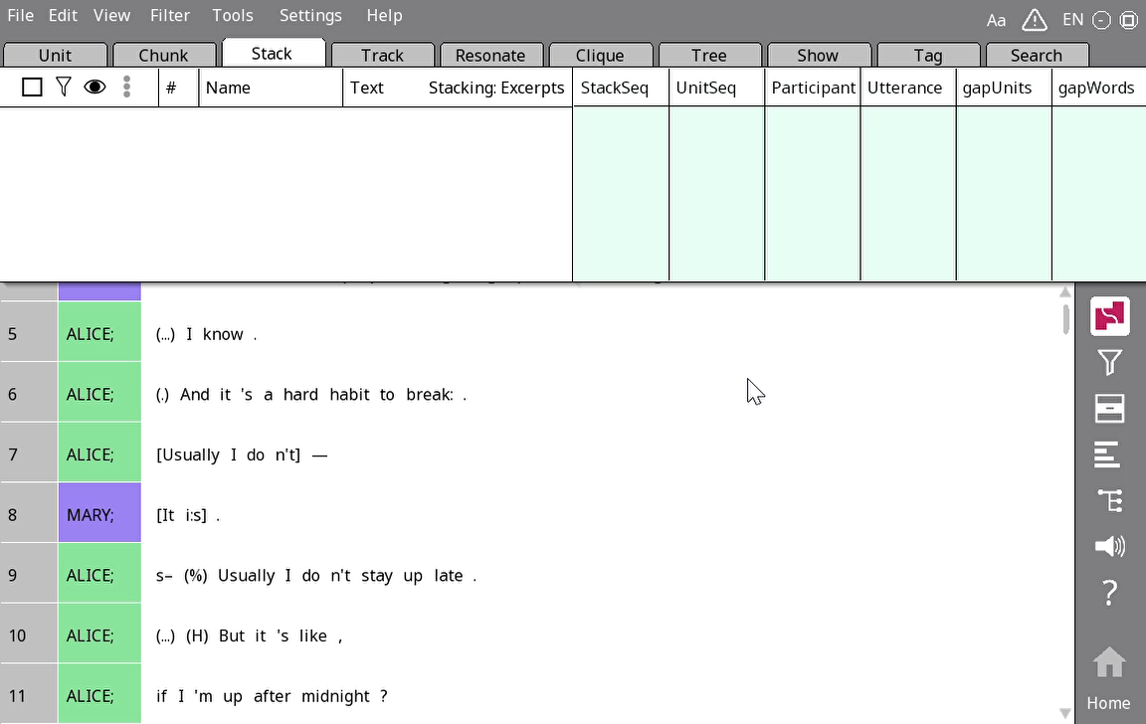
Creating and renaming a manual stack
Remember the example of overlap on lines 7-8?
Let’s say we want to present those lines in a slide.
We can get those lines plus a little bit of context to help the reader understand.
Create a stack and give it a meaningful title like ‘A hard habit to break’.

Slide 18
It’s showtime!
We can create a slideshow of examples within Rezonator
They are just called ‘shows’ (similar to our assignments)
Helpful for ‘bookmarking’ sections of the conversation to share with your friends

Slide 19
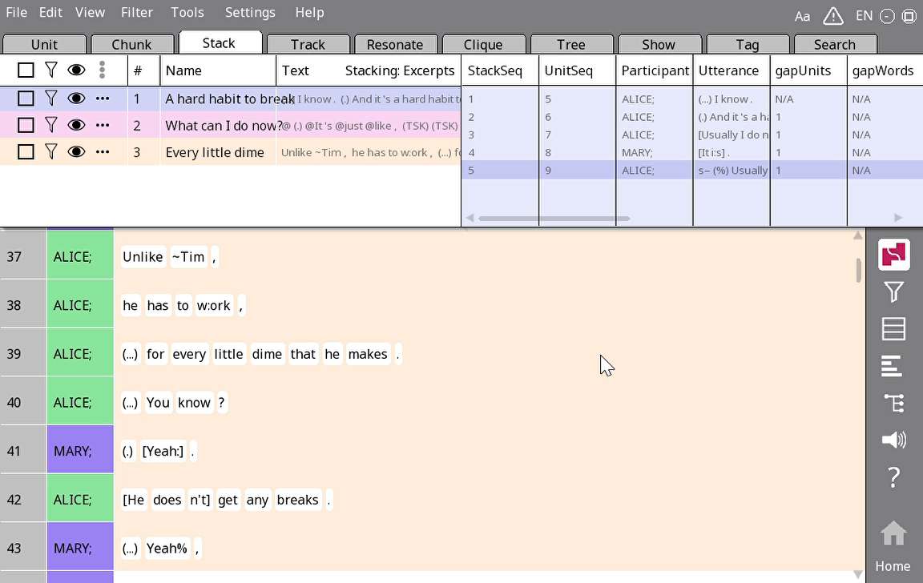
Creating shows
Right-click a stack, select Add to show > Create show
Add the other stacks with Add to show > Show 1
Go to the Show tab
Rename the show with a meaningful name (e.g. examples of transition space overlap)

Slide 20
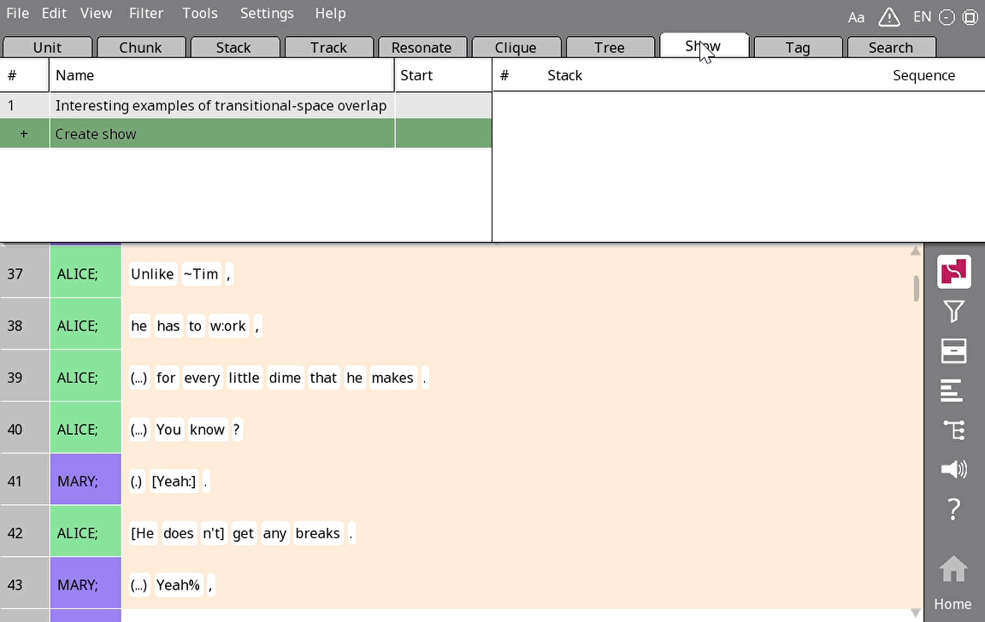
Showing shows
Go back to the Stack tab and choose which stacks you want to show people (e.g. TCU)
Return to the Show tab and click the play ▷ button
Use arrows (< >) to switch between examples

Slide 21
Your turn!
Identify some interesting TCUs in the conversation
For each example, put context necessary for understanding the TCU (including other TCUs in the turn or even other turns) inside a stack in the Excerpts stacking
Tell your groupmates what happens at the end of each TCU. Does the speaker continue speaking or select for the next speaker? Does someone else self-select?

Slide 22
Writing a good show: Structure
You need an introduction that clearly states what you will do in the show and defines key terms for the show
And a conclusion that sums up the major points briefly
Both can be very short for shows

Slide 23
Writing a good show: Main body
You should show evidence that you have engaged with all questions in the prompt (though sometimes there are questions you can answer together)
The majority of your show should be analysing specific examples
Each presentation of an example should include:
A topic sentence that tells us what point your example will show us
Brief context about the example necessary for us to interpret it
A Rezonator screenshot containing the example
An explanation of what is going on in the screenshot and how we should interpret it
An explanation of how the example links back to the main point of the paragraph

Slide 24
Writing a good show: Use of references
One reference to the readings will suffice for shows
You should find one point in your readings that goes well with what you see in the data
For example: There is an example analysed in the reading that is similar to an example you found in your conversation, so you analyse your example in a similar way

Slide 25
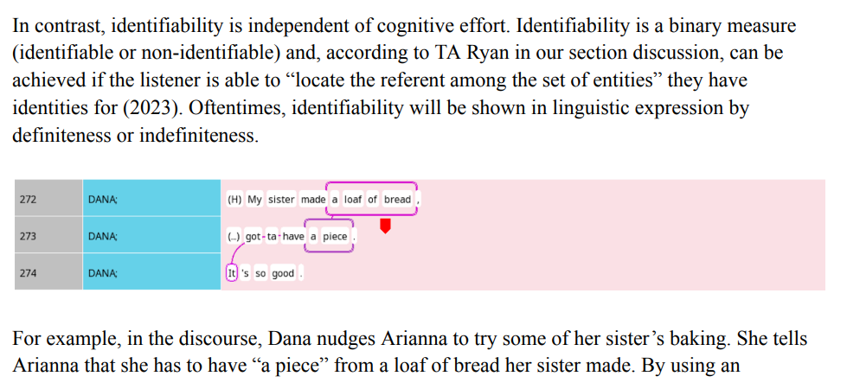
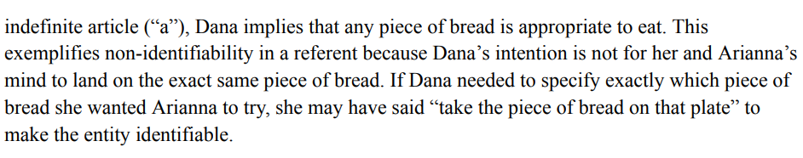
Giving the main point
Adding some context about the example before showing it would be ideal (though this one is self-explanatory enough that it reads fine)
Explaining what’s going on in the example
Linking back to the main point (about identifiability and definiteness)

Slide 26
Syntactic, prosodic and pragmatic completion: Ways of arguing for TCU boundaries (Show 2)
Syntactic completion: If the speaker stopped speaking here, will they have produced a complete sentence, or would you expect something to come afterwards?
Prosodic completion: Closure (rising/falling intonation) usually indicates completion, vs. continuing (stable/slight rise/slight fall)
Pragmatic completion: In terms of the meaning of the language produced, does it make sense to stop here are would you expect to hear more?

Slide 27
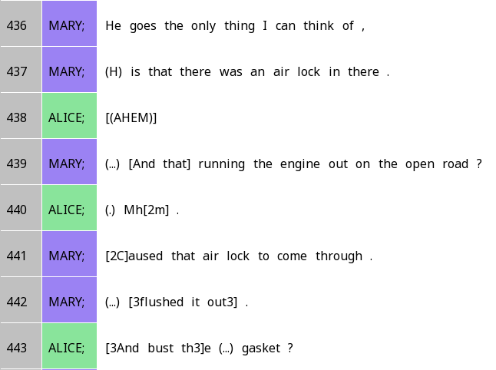

Using linguistic evidence: Why did Alice start speaking in line 443?
Prosodic completion: Falling intonation suggests that the TCU is complete
Syntactic completion: This is a complete sentence, with no indication that something should come after
Pragmatic completion: In terms of the context (explaining what happened with the oil leak + fire), this description seems to be complete

Slide 28
Self-selection, other-selection and Rule 1
Is the current speaking asking someone else to speak?
Yep
Nope
(1a) That someone else should now speak
Did someone else start speaking?
Yep
Nope
(1b) The first person to start speaking gets the right to speak (i.e. first-come-first-served)
(1c) The original speaker produces another TCU

